Slide 1
The Illinois Plumbing Licensing Law 225ILCS 320/35.5 and
SB0550, Signed By Governor Bruce Raunder January 16, 2017.
Protocol for testing lead in Potable water taps, Faucets, drinking
Fountains, and handwashing sinks used for
For Drinking or Cooking.
In all schools occupied by Pre-K – 5Th Grade

Slide 2
SCHOOLS MUST USE AN ILLINOIS ENVIRONMENTAL PROTECTION AGENCY (IEPA) ACCREDDITED LABORATORY FOR TESTING.
SAMPLING MUST BE COMPLETED BY:
*DECEMBER 31, 2017 - SCHOOLS CONSTRUCTED PRIOR TO JANUARY 1, 1987
*DECEMBER 31, 2018 – SCHOOLS CONSTRUCTED BETWEEN January 2, 1987 and January 1, 2000
SCHOOLS MUST PROVIDE THE ILLINOIS DEPARTMENT OF PUBLIC HEALTH (IDPH)
WITH SAMPLE RESULTS WITHIN 7 DAYS OF RECEIPT.
RESULTS SHOULD BE EMAILED TO DPH.LeadH2O@illinois.gov

Slide 3
PRIOR TO SAMPLING
1. Determine which IEPA accredited laboratory you will be utilized for analysis.
http://www.epa.Illinois.gov/citizens/citizens-information/in-your-home/resources-on-lead/index
2. Contact the laboratory to obtain enough 250mL sample bottles and Chain of Custody
forms to collect 2 samples from each fixtures.
3. Contact your local water supply to inquire about assistance in sample planning.
4. Obtain a general floor plan for each school building.
5. Identify all fixtures to be sampled:
* All plumbing fixtures used for cooking/drinking
X No bathroom/utility sinks
6. Assign unique alphanumeric identifier to each fixture and label these on the floor plan.

Slide 4
Do NOT collect samples on Mondays or after extended holidays.
Do not flush plumbing fixtures in advance of sampling.
WARNING!
USE CAUTION WHEN COLLECTING SAMPLE.
Some sample containers may contain
A nitric acid preservative that can cause skin
irritation.

Slide 5
Procedure for Sample Collection
STEPS FOR SAMPLE COLLECTION
1. Each fixture must be sampled twice:
a. First draw sample
b. Second draw sample after 30
seconds.
2. Label the sample bottles with the alphanumeric identifier, date, time and sample # 1 or #2. Do not open the sample bottles until you are ready to collect each sample.
3. Ensure water has been idle and unused in pipes and fixtures for at least eight hours, but not more than 18 hours.
4. Position the first sample beneath fixture and turn water on. DO NOT ALLOW ANY WATER TO SPILL.

Slide 6
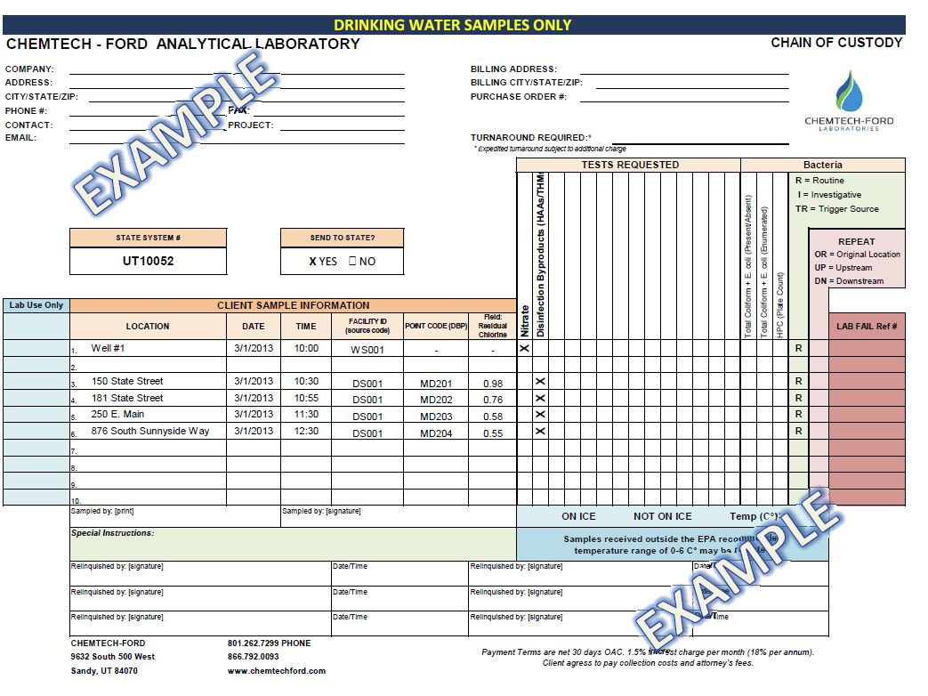
Procedure for Sample Collection continued
5. Fill Bottle to 250mL line and turn water off.
6. Cap 1st sample bottle.
7. Turn water back on and allow it to
run 30 seconds before following same
instructions to obtain 2nd sample.
8. Fill out a Chain of Custody sheet for each sample.
9. Follow laboratory shipping instructions,
and send to the lab for analysis.

Slide 7
NEXT STEPS
*Anticipate questions from parents and the public about steps being taken
to address lead in the water
*Establishment of a water management plan is best course of action
*Guidance for interim (short-term) and permanent lead control measures is provided in
USEPA 3Ts for Reducing Lead in Drinking Water in School found here
www.epa.gov/sites/production/files/201509/documents/toolkit_leadschools_guide_3ts_leadschools.pdf

Slide 8
Waivers for water testing mAy be granted by the Illinois department of public health (idPH) If A school tested its potable water sources before January 17, 2017 *if the school meets all sampling AND TESTING REQUIREMENTS IN SECTION 35.5 C(5)* ALL Waiver REQUEST SHOULD BE MADE BY EMAILING THE SAMPLE TEST RESULTS TO DPH.LEADH2O@ILLINOIS.GOV

Slide 9
Section 35.5 Sampling and Testing Requirements for Waiver
The school district or chief school admin, or designees of school district or chief school administrator, collected at least 250 milliliter or greater sample of water from each source of potable water that had been standing in the plumbing pipes for at least 6 hours and that was collected without flushing the source of potable water before collection;
An Illinois Environmental Protection Agency-accredited laboratory analyzed the samples;
Test results were obtained prior to the effective date of the amendatory Act of the 99th General Assembly but after January 1, 2013; and
Test results were submitted to the Department within 120 days of the effective date of this amendatory Act of the 99th General Assembly.
If school tested some but not all required potable water resources, the school must test all un-sampled water sources and send to IDPH with Waiver request

Slide 10
IDPH MAY REQUIRE ADDITIONAL INFORMATION BEFORE ISSUING WAIVERS:
*PLUMBING PROFILE (IF AVAILABLE)
*FLOOR PLAN/MAP SHOWING LOCATION OF LEAD PIPES, FIXTURES, OR OTHER KNOWN SOURCES OF LEAD IN WATER
*SAMPLING PLAN AND PROCEDURES (FOR SAMPLES TAKEN PRIOR TO JANUARY 17, 2017

Slide 11
ILLINOIS DEPARTMENT OF HEALTH WILL
DENY WAIVER REQUESTS
IF THE SCHOOLS:
FAIL TO SAMPLE ALL REQUIRED WATER SOURCES
DO NOT HAVE THE SAMPLES TESTED BY AN IEPA-CERTIFIED LABORATORY
DO NOT CHOSE A LABORATORY THAT IS ABLE TO DETECT LEVELS OF LEAD AT
LESS THAN 5 PARTS PER BILLION
IF IDPH DENIES THE WAIVER, THE SCHOOL MUST RESAMPLE ALL REQUIRED POTABLE
WATER RESOURCES INCLUDED IN ORIGINAL WAIVER REQUEST.

